Slide 1
New Types of Data
And Policy Research
Thanks to Frauke Kreuter, Henry Brady

Slide 2
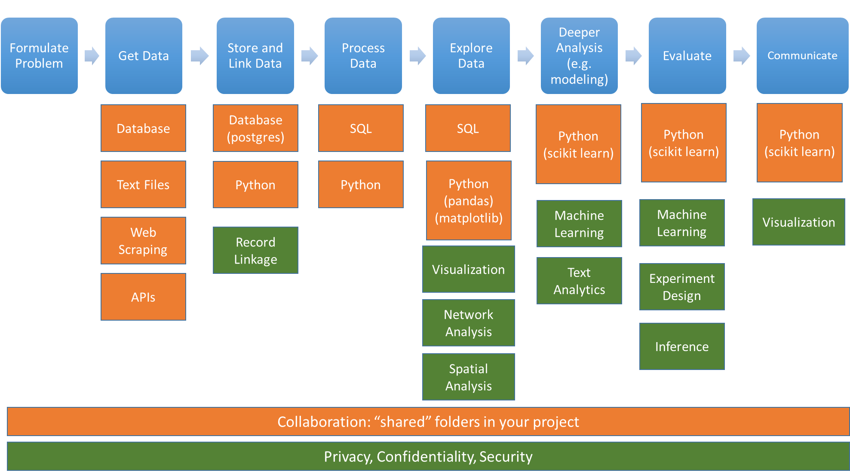

Slide 3
Outline
Context
Types of data
Measurement
Inference
Project Scoping

Slide 4
Outline
Context
Types of data
Measurement
Inference
Project Scoping

Slide 5
Your first assignment
Why is this an important topic to study? (2 points)
What have others done before? (2 points)
What is your contribution? (2 points)
What is the policy implication? (2 points)
What kind of methods would you like to explore (2 points)

Slide 7
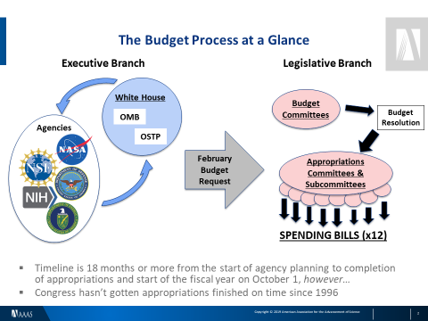
Overview of funding in the United States
https://www.aaas.org/programs/r-d-budget-and-policy
https://www.aaas.org/resources/presentations-0

Slide 10

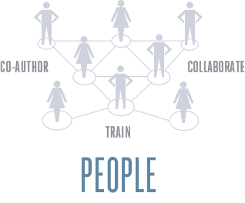

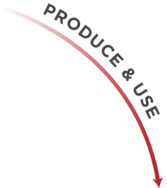



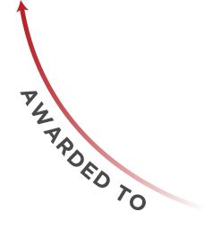
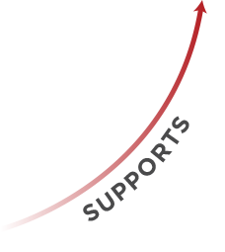

Conceptual Framework

Slide 11
Outline
Context
Types of data
Measurement
Inference
Project Scoping

Slide 12
Types of Data
Administrative Data
Good: Data of record; complete populations; sensitive hard-to-get data
Bad: Lack of denominator data; lack of demographics; low quality of some data; complexities of linkage; problems of privacy
Internet Data
Good: Network data; dynamic data; unobtrusive measure of culturally disapproved topics
Bad: Self-selection into platforms; missing data; problems of privacy
Textual Data
Good: Much faster than human coding; large bodies of data
Bad: “Bag of words” paradigm; complicated and “touchy” estimation methods; requires excellent training sets
Sensor, Audio, and Video
Good: Often real time; geographically broad coverage; very detailed
Bad: Difficulty of processing—especially video; Modifiable areal unit problem; problems of privacy

Slide 13
Administrative Data Used in Policy Research
Longitudinal Employer-Household Dynamics (https://lehd.ces.census.gov/)
Unemployment Insurance Wage Records
Tax Data
Medicaid/Medicare data
Social Security Notifications
TANF/SNAP

Slide 14

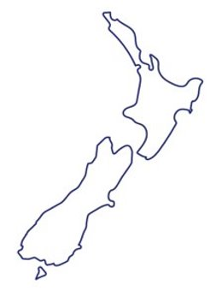
The New Zealand context
Health
NZ Super
Social security and welfare
Education
Other
Core Governmentservices
Finance costs
Transport and communication
Law and order
Defence
Budget 2018
Budget 2018
Sir Bill English, Former NZ PM

Slide 15


What do we mean by integrated data?
1 | 2 | 3 | 4 | 5 | 6 | 7 | 8 | 9 | 10 | 11 | 12 | 13 | 14 | 15 | 16 | 17 | 18 | 19
^{Aged}
^{CYFS}
^{Abuse Findings}
^{Care}
^{Education}
^{Youth Justice}
^{Income support}
^{Total cumulative paid ($1000)}
 |  | 6 |  |  |  | 18 |  |  | 37 |  |  | 53 | 58 | 71 | 120 | 126 | 127 | 142

Slide 16
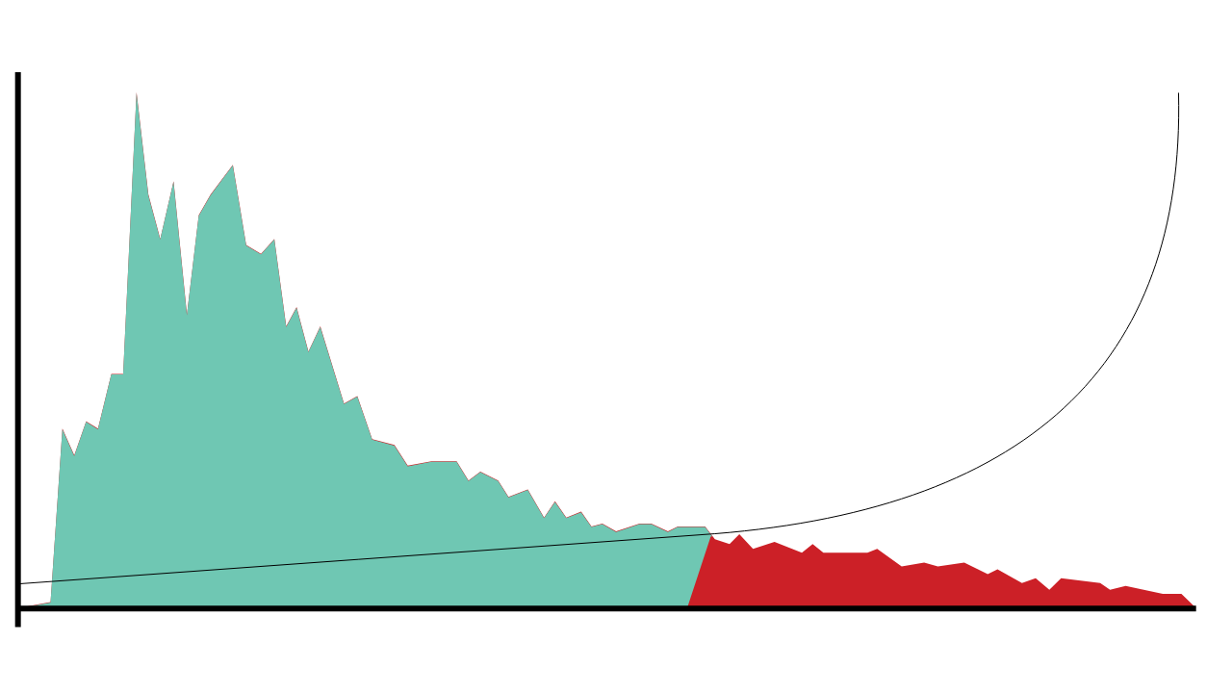

Understanding risk
The risk profile of this cohort reveals a long tail of increased risk.
2,500
The hypothetical cost effectiveness of interventions increases when they are delivered to the students who need them most.
48,077 low-risk students have an average risk of 27%
Number of students
1,250
6,990 high risk students have an average risk of 76%
0
0%
100%
Risk of not achieving NCEA2 by age 18

Slide 17
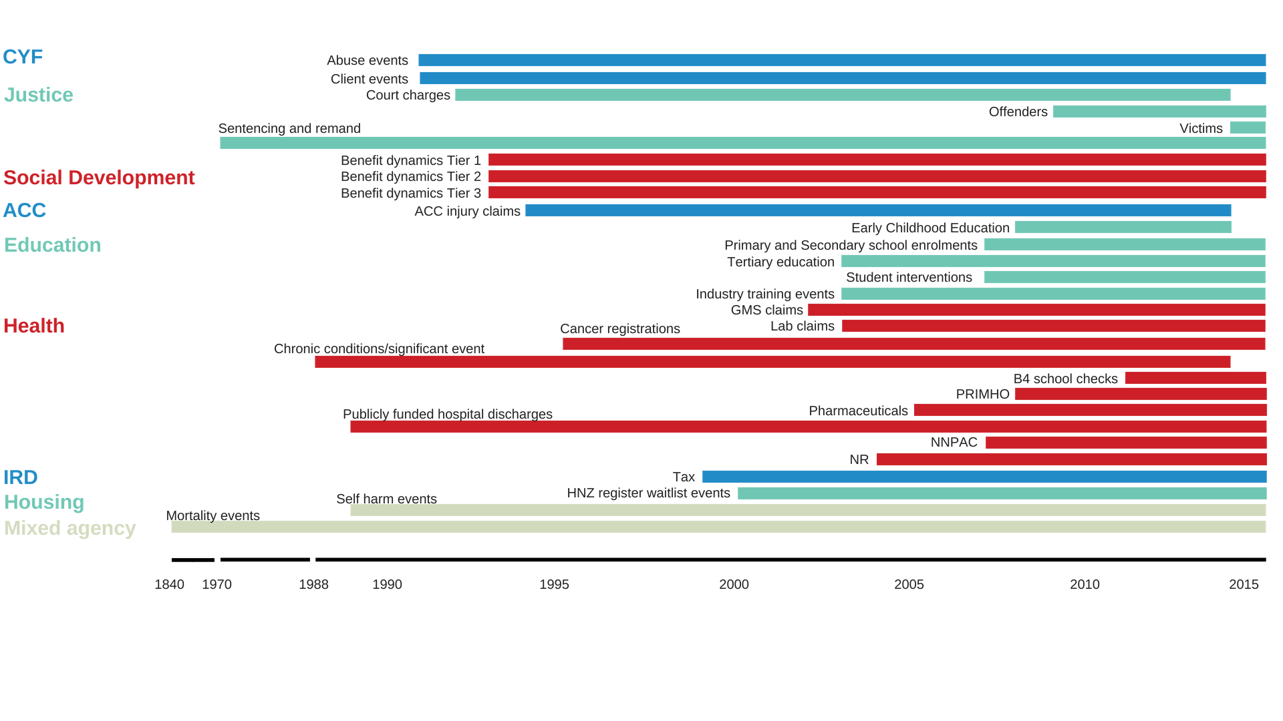
The Integrated Data Infrastructure (IDI)

Slide 18
Aggregate liability valuation
Total liability
72.2 billion
$13.7 billion​
Increase due to policy package to reduce child poverty – because of the method we employ, this can be isolated
Liability decrease related to experience, $billions
Liability reduction
attributable to system reform
Updated model assumptions
Client numbers

Slide 19

Reducing social harm from crime
Of the cohort born in 1978, the oldest generation for which full conviction data is available:
One in four people have a conviction
80%
One in three men have a conviction
of convictions went to individuals who were first convicted before the age of 20
One in two Maori or Pasifika men have a conviction

Slide 20
Seeing outside the silo
Integrated data generated insights into the relationship between traumatic brain injury and offending...
13% of the general population
36% of people charged in court
46% of people imprisoned
People charged in court who had a TBI were, on average,
3 years younger
at first charge
have a traumatic brain injury recorded in hospitalisation or ACC claims data.
Offenders with a recorded traumatic brain injury were more likely to have committed violent or sexual offences...
TBI
37%
38%
27%
No TBI
23%
35%
42%
… than offenders who had not.
Convicted for violent or sexual offence
Convicted for other offence
Not convicted

Slide 21

Seeing outside the silo
... and offenders' experiences of the mental health and education systems
Prevalence of mental health service use within 12 months of Justice interaction (2012)
60%
Of the 1500 prisoners born after 1990
69%
left school before they turned 18, compared with
32%
of the total NZ population
30%
51%
had been suspended from school
5%
compared to
of the overall population
0%
General population
Proceeded against
by police
Charged in court
Starting community sentence

Slide 22
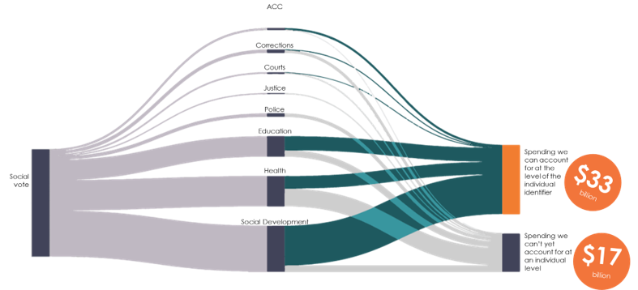
Understanding return on investment
We're able to link two thirds of service costs to individuals

Slide 23
Common Surveys Used in Policy Research
General Social Survey (http://gss.norc.org)
American Community Survey (https://www.census.gov/programs-surveys/acs)
Current Population Survey (https://www.census.gov/programs-surveys/cps.html)
National Longitudinal Surveys (https://www.bls.gov/nls/)
Survey of Income and Program Participation (https://www.census.gov/sipp/)
Panel Study of Income Dynamics (https://psidonline.isr.umich.edu/default.aspx)

Slide 24
Survey Data are ...
Specifically targeted to research question
Survey design
Diverse in topics (very detailed questions)
But:
Expensive
Response rates
Biases in answers
Small number of observations

Slide 25
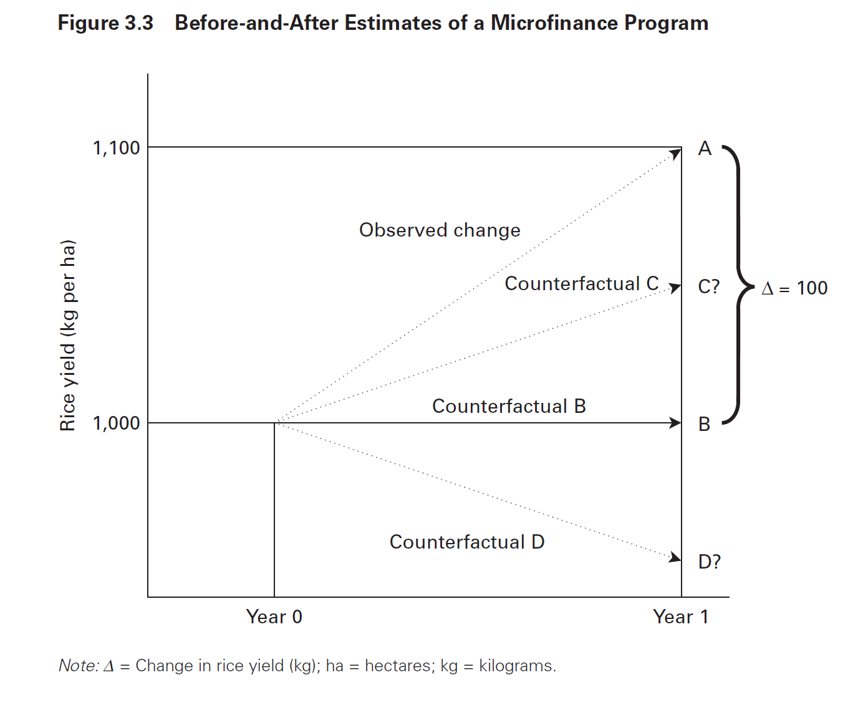
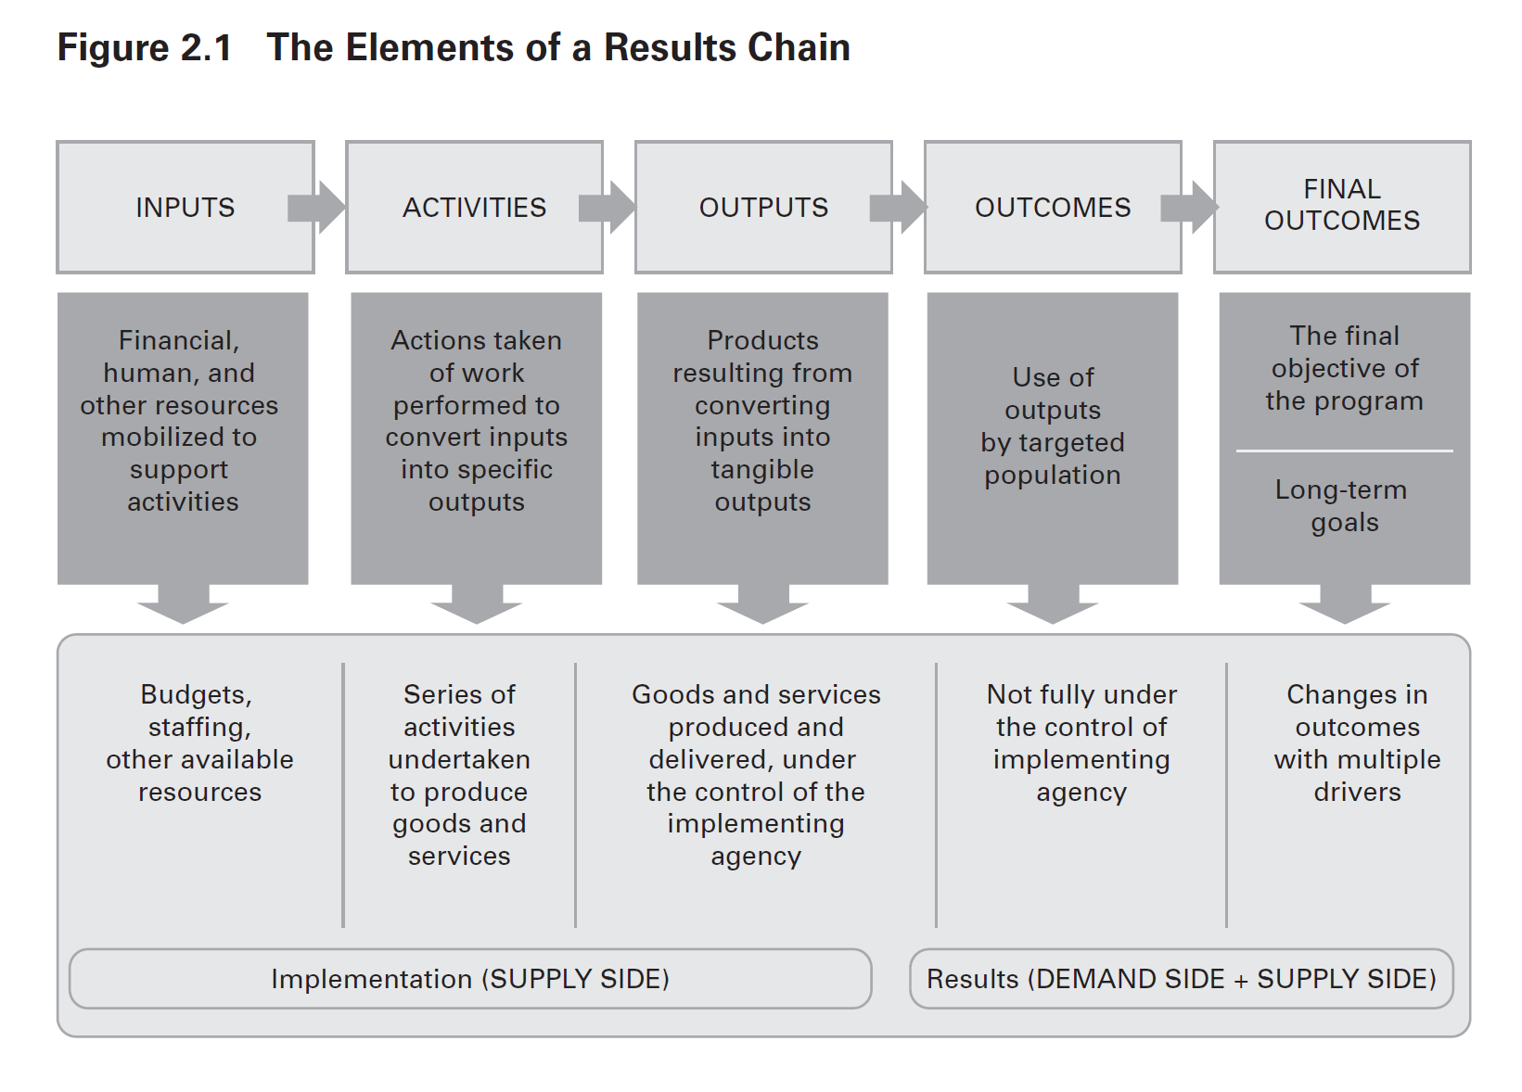

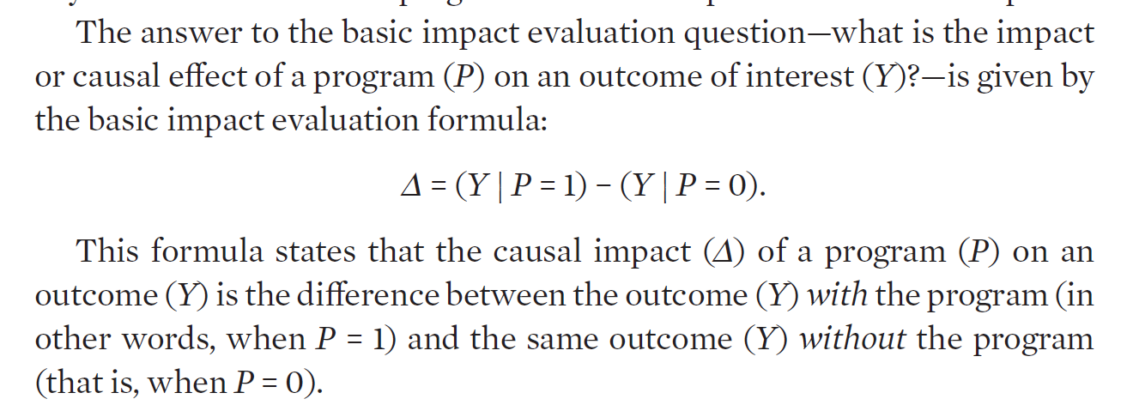

Slide 26
Data for this class
What has been funded (Transaction)
Text documents
Text analysis
Who has been funded
HR records (individual (plus job title) x grant x pay period)
Inputs
Financial records (vendor x transaction x transaction period)
What are the results
Economic – Census and USPTO data (Administrative)
Scientific – Pubs/scientific communications

Slide 27
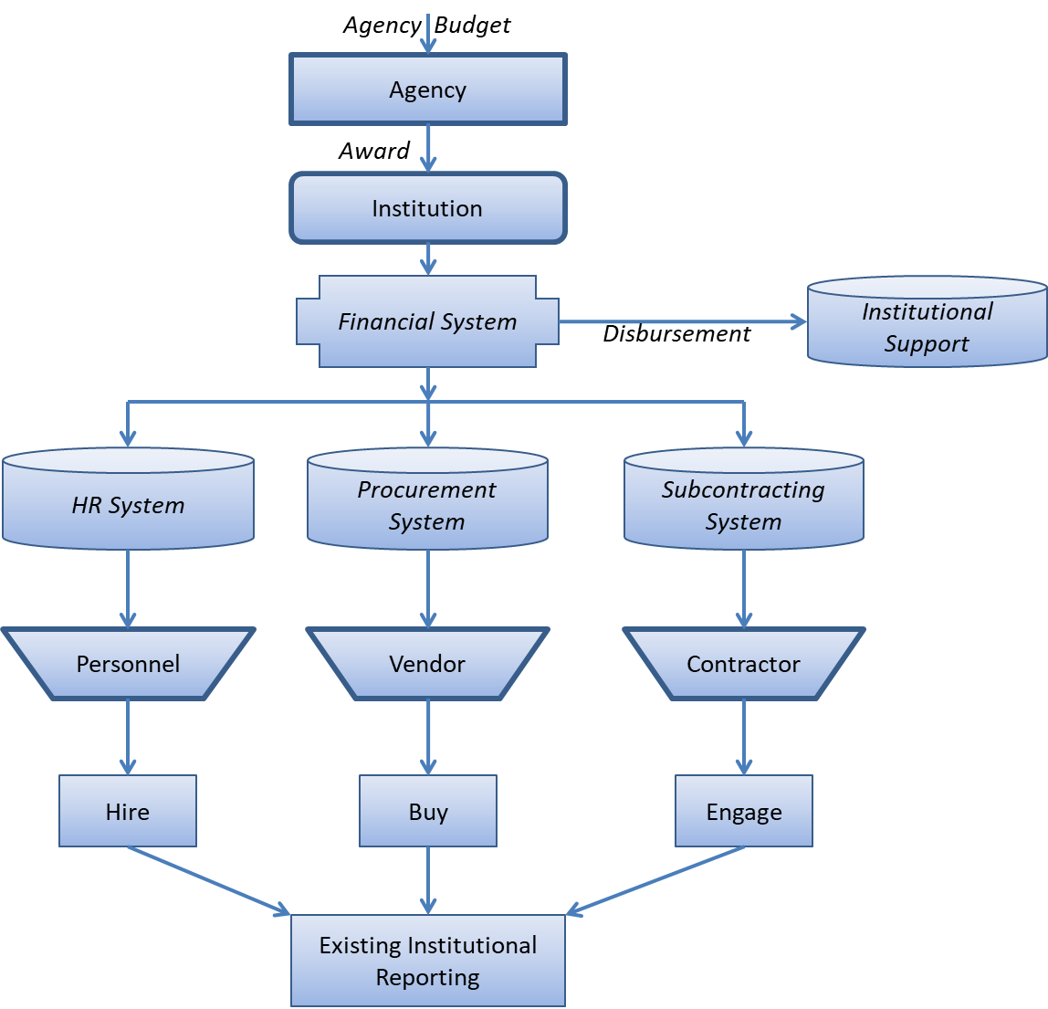
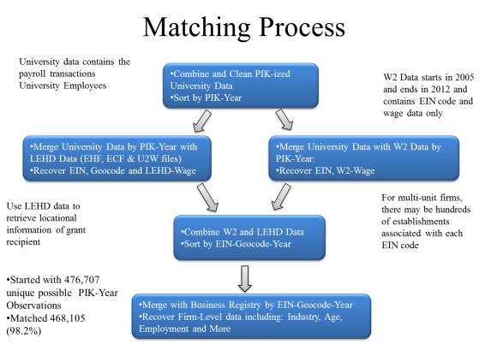
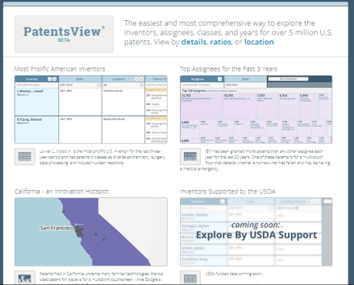
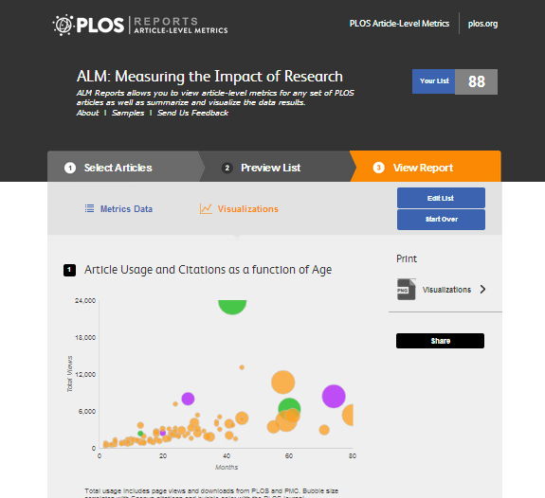
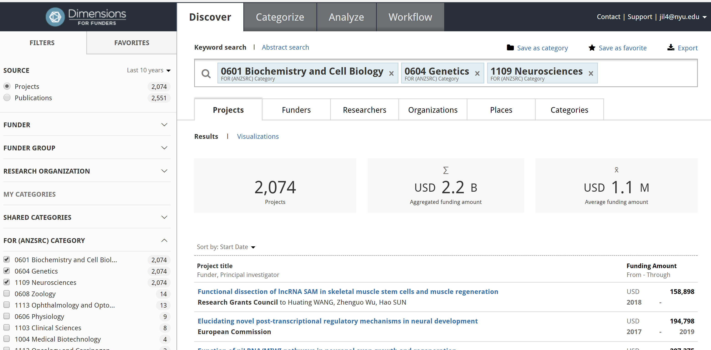
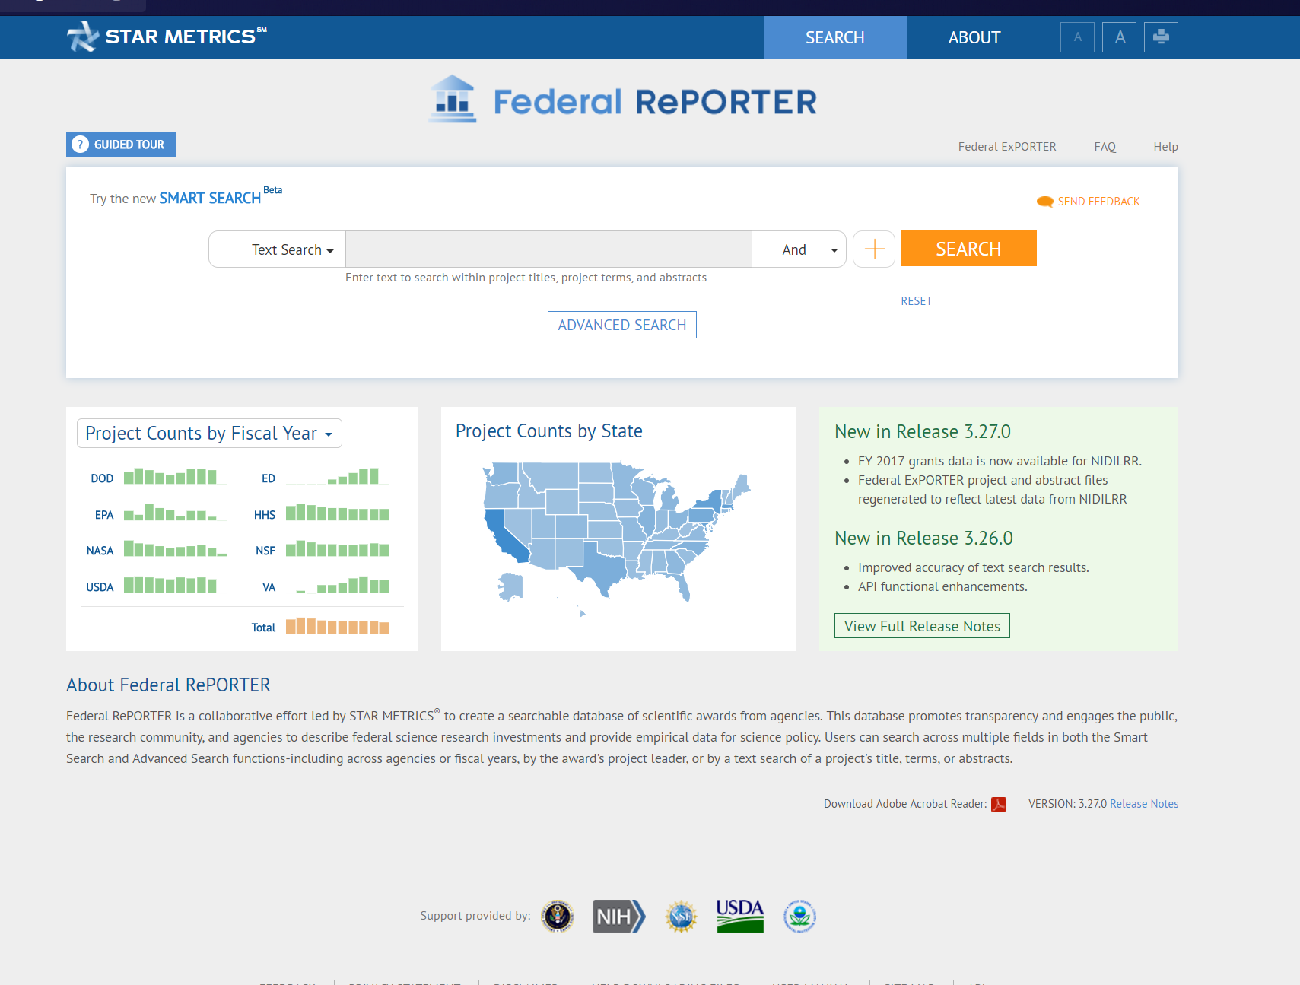
The Empirical Framework: Big Data

Slide 28
The data infrastructure
What has been funded
Text documents
Text analysis
Who has been funded
HR records (individual (plus job title) x grant x pay period)
Inputs
Financial records (vendor x transaction x transaction period)
What are the results
Economic – Census and USPTO data
Scientific – Pubs/scientific communications

Slide 29
What has been funded

Slide 30

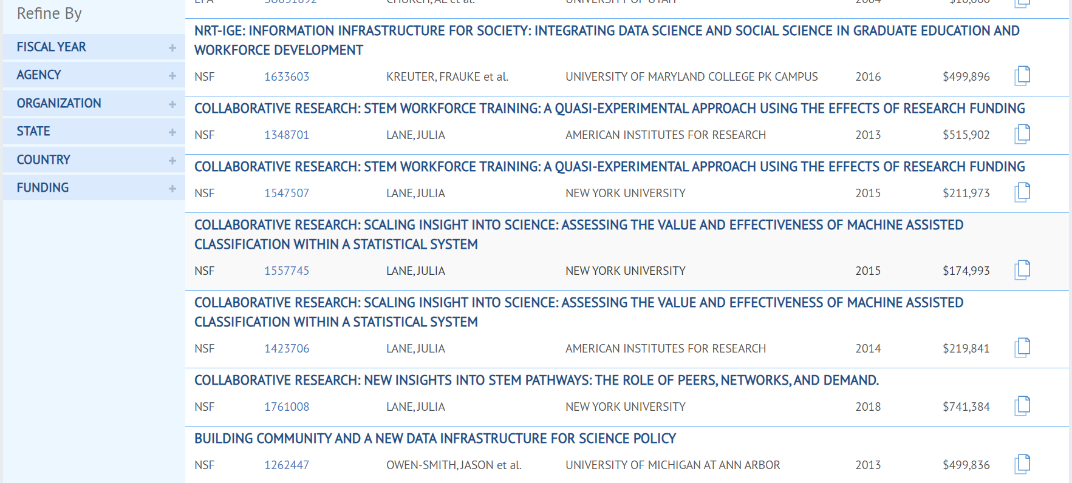
Detail

Slide 31
The data infrastructure
What has been funded
Text documents
Text analysis
Who has been funded
HR records (individual (plus job title) x grant x pay period)
Inputs
Financial records (vendor x transaction x transaction period)
What are the results
Economic – Census and USPTO data
Scientific – Pubs/scientific communications

Slide 32
Agency Budget
Agency
Award
Institution
Financial System
Institutional Support
Disbursement
HR System
Procurement System
Subcontracting System
Personnel
Vendor
Contractor
Hire
Buy
Engage
Existing Institutional Reporting

Slide 33
The data infrastructure
What has been funded
Text documents
Text analysis
Who has been funded
HR records (individual (plus job title) x grant x pay period)
Inputs
Financial records (vendor x transaction x transaction period)
What are the results
Economic – Census and USPTO data
Scientific – Pubs/scientific communications

Slide 34
What results
UMETRICS DATA
University data on Federal awards:
Employee, vendor, subaward transactions
CENSUS DATA
Secure data on people and businesses:
Employment records, business dynamics & characteristics
Employee Name/DOB
Organization Name/Location
VENDOR CHARACTERISTICS
JOB PLACEMENTS
START-UP ACTIVITY
PATENTS
Where research employees get their next jobs
What types of businesses research employees found
What types of patents are generated?
What types of businesses supply research
Analyze by: Occupational category | Funding agency | Research area | Years since leaving university

Slide 35
What is a patent?
A property right that allows the owner to –
“exclude others from making, using, offering for sale, or selling the invention throughout the United States or importing the invention into the United States“
Many varieties:
Non-Provisional patents (utility, plant, and design)
Provisional patents (utility and plant)

Slide 36

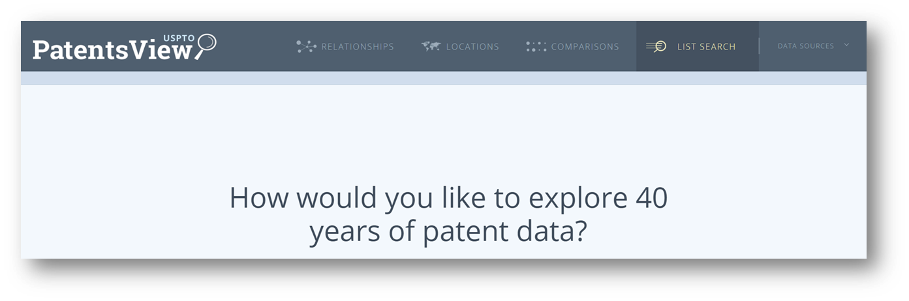
Notes:
To one more dedicated to visualizing and exploring the data through different touchpoints
Consistently told that the “Detailed” dashboard views of each patent, inventor, assignee and location were the most interesting but to difficult to get to through Search alone
New visualization interface emphasizes exploring the data through visualizations
Provided multiple, new entry points to detailed views
Enable users to engage more with patent data without knowing exactly what they are looking for

Slide 37
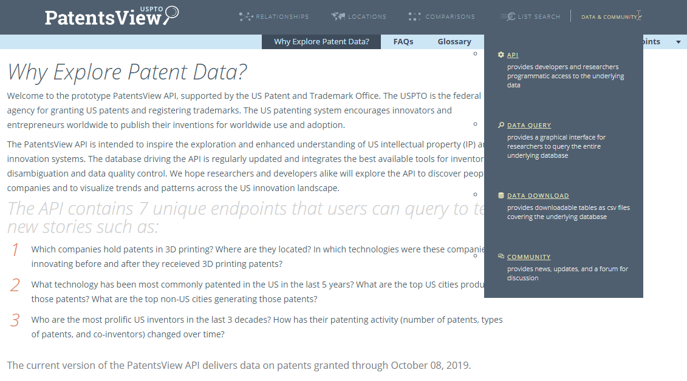
Notes:
To one more dedicated to visualizing and exploring the data through different touchpoints
Consistently told that the “Detailed” dashboard views of each patent, inventor, assignee and location were the most interesting but to difficult to get to through Search alone
New visualization interface emphasizes exploring the data through visualizations
Provided multiple, new entry points to detailed views
Enable users to engage more with patent data without knowing exactly what they are looking for

Slide 38

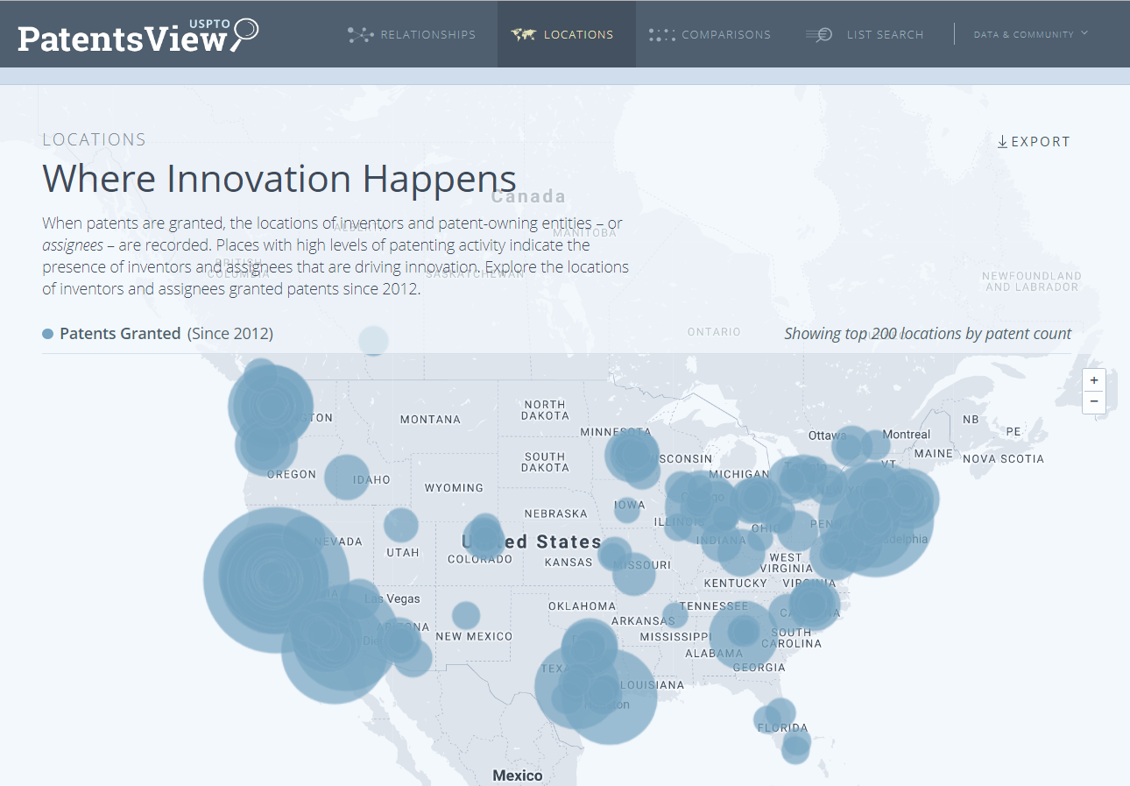

PatentsView usage
76K API queries per day
20.7M total API queries
674K total files downloaded
176 hits per day to patent visualization & search interface
Source: PatentsView user statistics for 2019 (through Sept 2019)

Slide 39
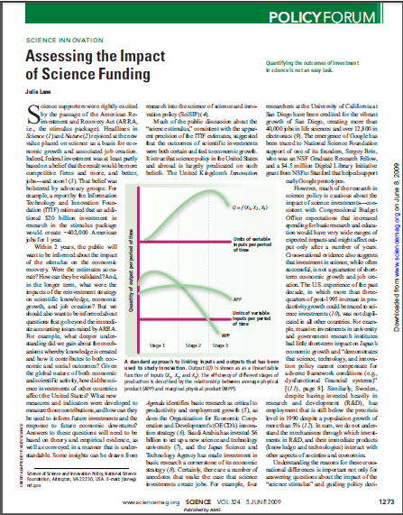

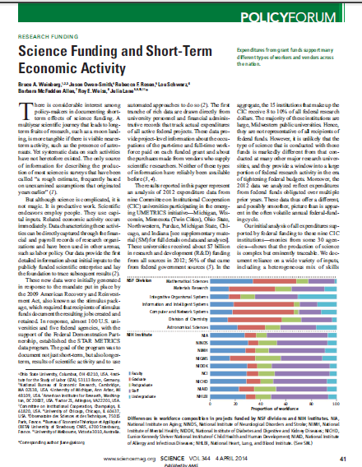
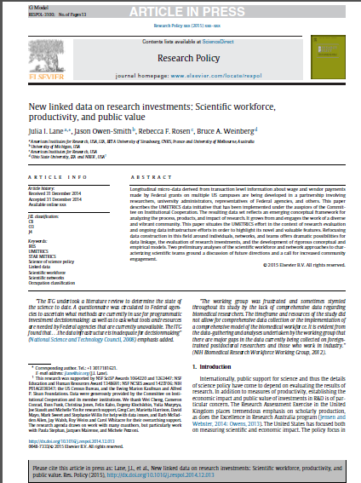
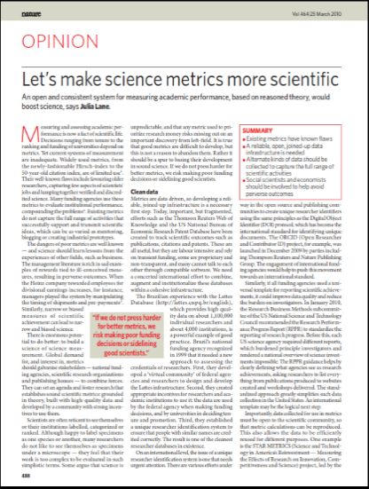
Examples of Research…

Slide 40
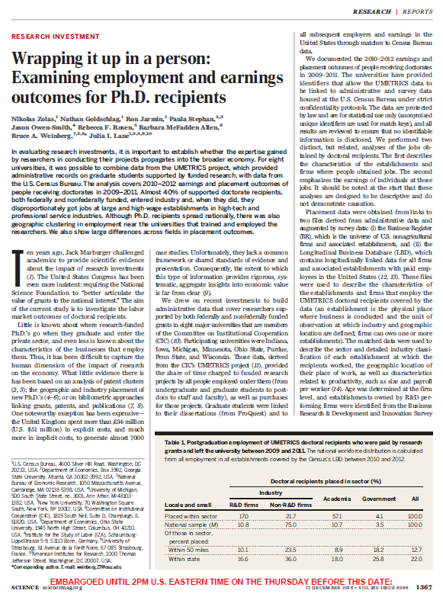

http://www.sciencemag.org/content/350/6266/1367.abstract

Slide 41
Outline
Context
Types of data
Measurement
Inference
Project Scoping

Slide 42
Seven economic concepts approximated using patent data
Knowledge flows – information feeding invention
Technology transfer – invention or IP flows
IP strength – indexes at the entity or regional level
IP intensity – for industries or firms
Technological proximity – for countries, industries, firms
Inventor mobility – people feeding invention
Innovation – patents represent innovation

Slide 43
Policy Example 1: Inventor Diversity
Specific policy objective
2018 Congressional SUCCESS Act
To promote diversity and inclusiveness in the population of U.S. patent inventors
To describe the nature and trends in patenting among female inventors

Slide 44
Policy Example 1: Inventor Diversity
Nature of data
USPTO does not collect information on gender, race, ethnicity or veteran status from inventors
USPTO collects data related to pre and post-grant operational needs

Slide 45
Policy Example 1: Inventor Diversity
Must use the data to develop metrics that can be interpreted for policy objectives
Must infer gender of an inventor based on available data
New USPTO report ,“Progress and Potential: A profile of women inventors on U.S. patents” https://www.uspto.gov/sites/default/files/documents/Progress-and-Potential.pdf

Slide 46


Metrics: share of patents vs. inventors
Share of patents with a female inventor: The percentage of patents granted in a given year with at least one female on the inventor team.
Women inventor rate: The percentage of all unique inventors granted a patent in a given year that are women.
50% of patents with at least one female inventor
50% of patents with at least one female inventor
50% women inventor rate
10% women inventor rate

Slide 47
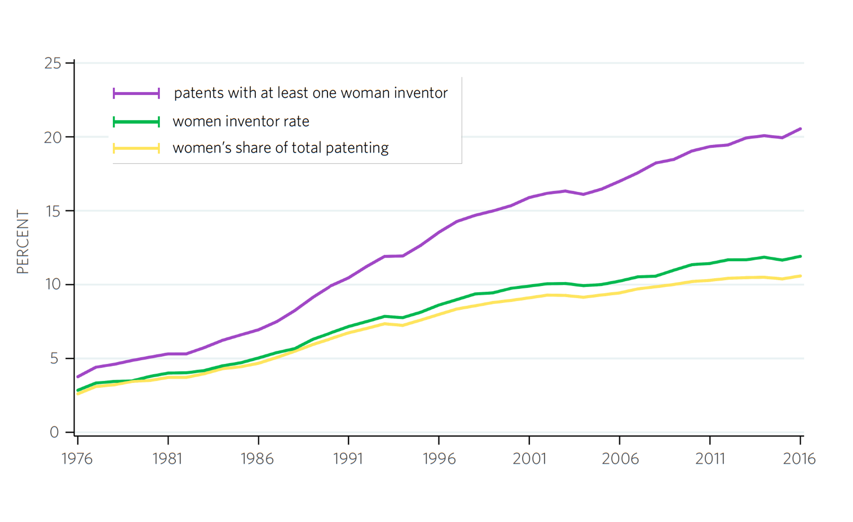
Forty-year trends of women in U.S. patenting

Slide 48
Policy Example 2: Serving Stakeholders
Specific policy objective
The 2011 Leahy-Smith America Invents Act established the requirement for USPTO to set up regional offices
To expand engagement and outreach to current and potential USPTO patent and trademark customers
To descriptively identify and characterize USPTO customers

Slide 49
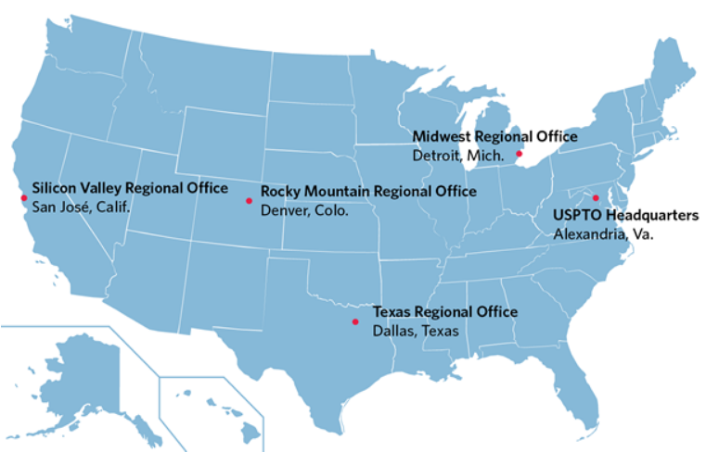

Slide 50
What’s happening in these regions?
How many innovators are there in the regions?
How many patent and trademark applicants, owners (TM registrants) are there in the regions?
Are these innovators and filers large or small companies, start-ups, or individuals?
What are the total fees in a particular year USPTO collects from these entities?

Slide 51
Outline
Context
Types of data
Measurement
Inference
Project Scoping

Slide 52
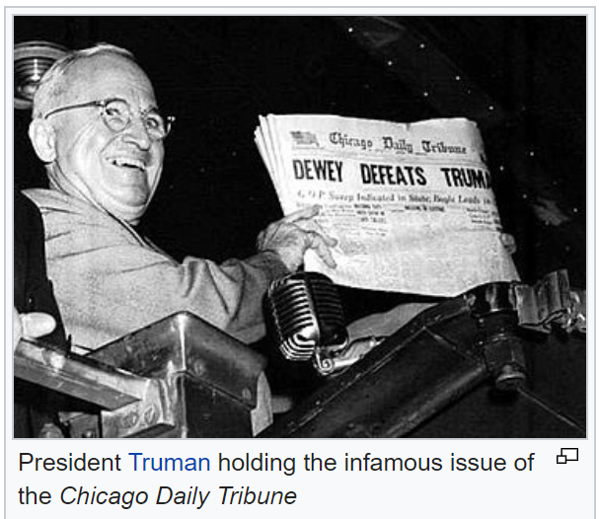

Slide 53
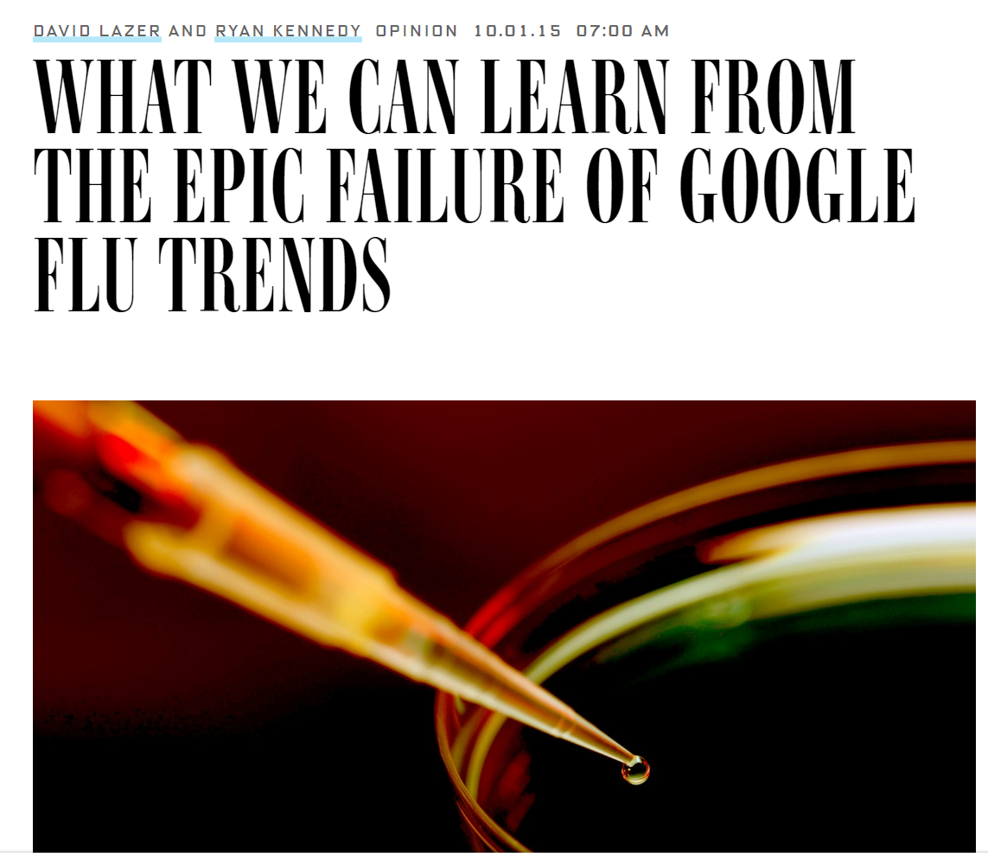

Slide 54









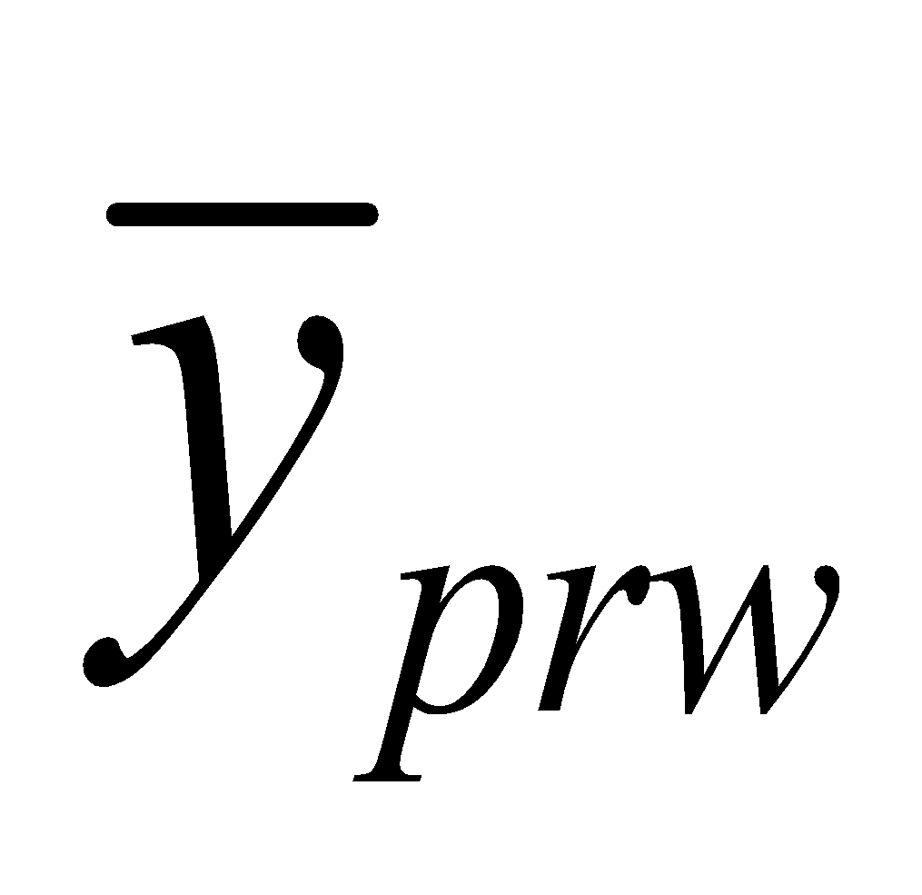
Measurement
Representation
Construct
Target Population
Sampling Frame
Measurement
Sample
Response
Respondents
Edited Response
Adjustments
Survey Statistic

Slide 55
Measurement
Construct
police reported crime
“During the last 6 months, did you call the police to report something that happened to you that you thought was a crime?”
Measurement
Response
Edited Response
Survey Statistic

Slide 56
Measurement
Construct
Extent to which measure reflects construct over all possible trials
Validity
Measurement
Response
Edited Response
Survey Statistic
Notes:
defining validity for this simple case of response deviations from the true value. Validity is the correlation of the measurement, Yi, and the true value, µi, measured over all possible trials t and persons

Slide 57
Measurement
Construct
police reported crime
“During the last 6 months, did you call the police to report something that happened to you that you thought was a crime?”
Measurement
“I called them about my neighbor’s car hitting my mailbox.” – Interviewer records 1 for “Yes”.
Response
Edited Response
Survey Statistic

Slide 58
Measurement
Construct
Departure of response to a measure from true value of measure for a respondent
Measurement
Classical error model (Lord & Novick 1969)
y_{i} = Y_{i} + ε_{i} , with ε ~ N(0, σ)
perfect measurement means σ = 0.
[Tourangeau, Rips, Rasinski 2000; Krosnick & Presser 2010; Biemer et al. 2013; Vannette & Krosnick 2018]
Measurement Error
Response
Edited Response
Survey Statistic

Slide 59
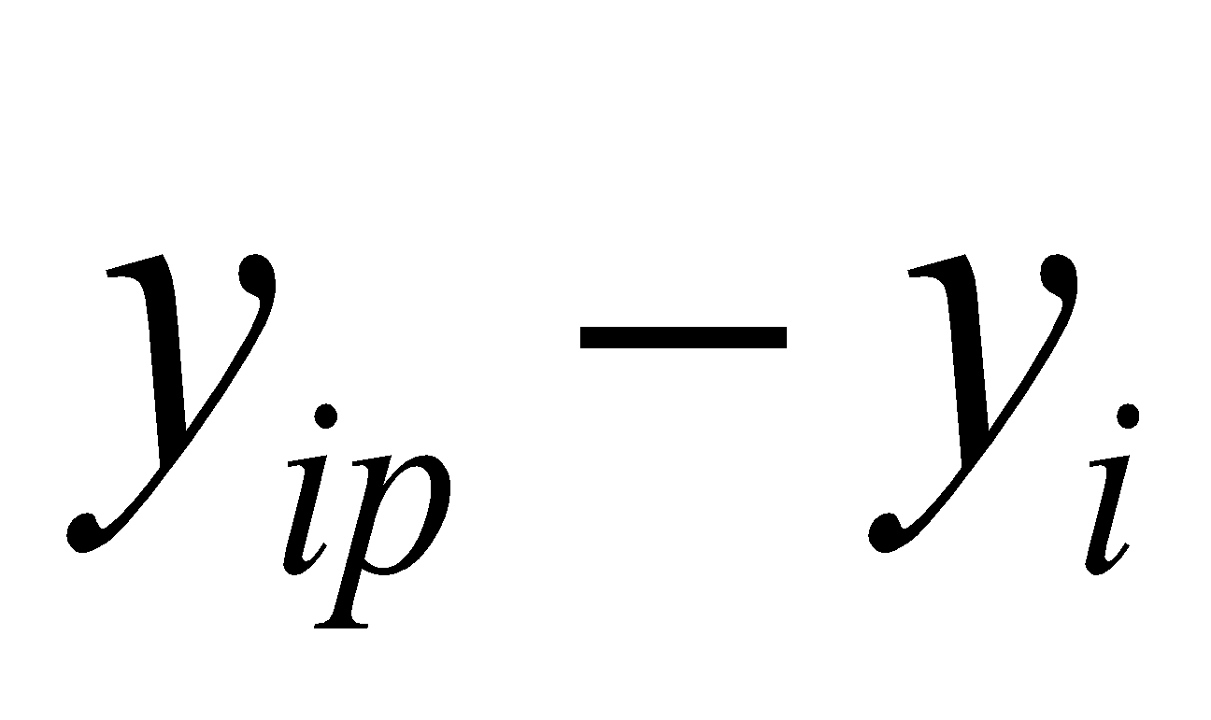
Measurement
Construct
Measurement
Response
Departure of data from true value due to coding or editing of response
Processing Error
Edited Response
Survey Statistic

Slide 60
Representation
US HH population, 12 years and over
Target Population
Persons linked to housing units at listed address in sample areas
Sampling Frame
Sample
Respondents
Adjustments
Survey Statistic

Slide 61
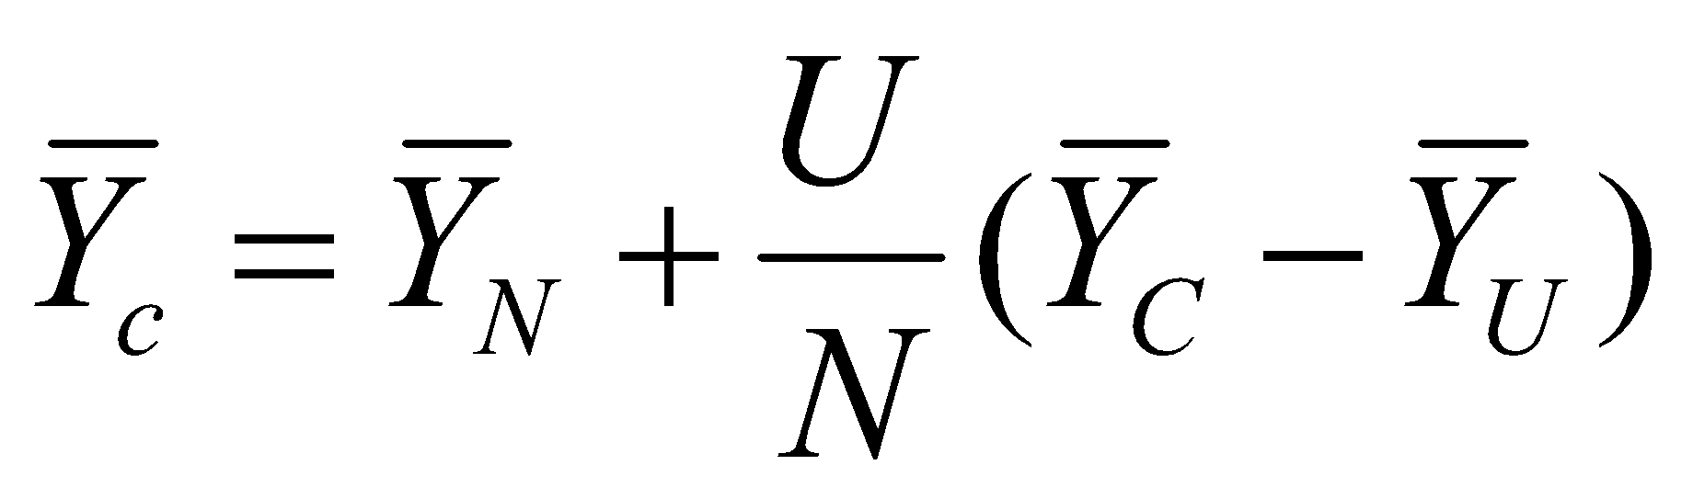
Representation
Target Population
Difference between covered and noncovered population
Coverage Error
Sampling Frame
Sample
Respondents
Adjustments
Survey Statistic

Slide 62
Representation
US HH population, 12 years and over
Target Population
Persons linked to housing units at listed address in sample areas
Sampling Frame
Multistage area probability sample of persons in sample HH
Sample
Respondents
Adjustments
Survey Statistic

Slide 63
Representation
Target Population
Sampling Frame
Sampling bias vs. sampling variance
Sampling Error
Sample
Respondents
Adjustments
Survey Statistic

Slide 64
Representation
US HH population, 12 years and over
Target Population
Persons linked to housing units at listed address in sample areas
Sampling Frame
Multistage area probability sample of persons in sample HH
Sample
Persons providing answers to interviewer-administered questionnaire
Respondents
Adjustments
Survey Statistic

Slide 65

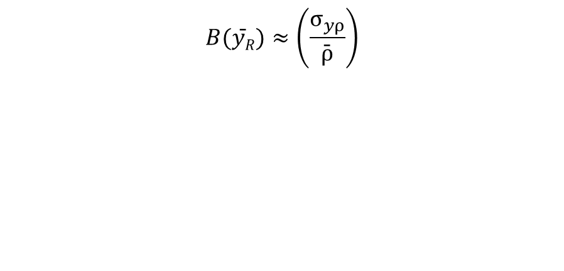
Representation
Target Population
Values of statistic computed based only on respondent data differ from those based on entire sample
Sampling Frame
Sample
Nonresponse Error
Respondents
Adjustment Error
Adjustments
Survey Statistic
Notes:
where R y is the unadjusted estimate of a mean from the responding units, y ρσ
is the correlation between the response propensities and the survey variable, and
ρ is the average response propensity. It should be clear from this formulation that a higher
response rate does not imply a reduction in bias as the correlation term, y ρσ
, can change in a nonlinear fashion as response rates change. If, for example, a higher response rate

Slide 66
Outline
Context
Types of data
Measurement
Inference
Project Scoping

Slide 67
Project Scoping
Step 1: Goals – Define the goal(s) of the project Step 2: Actions – What actions/interventions do you have that this project will inform? Step 3: Data – What data do you have access to internally? What data do you need? What can you augment from external and/or public sources? Step 4: Analysis – What analysis needs to be done? Does it involve description, detection, prediction, or behavior change? How will the analysis be validated?
Step 5: Literature Review: What have others done?

Slide 68
Your first assignment
Why is this an important topic to study? (2 points)
What have others done before? (2 points)
What is your contribution? (2 points)
What is the policy implication? (2 points)
What kind of methods would you like to explore (2 points)

